Slide 1

Cryptocurrency Database Project
Group Members: Ali Sadeghinia, Brooke Harris, Sai Pramod Kantheti, Sai Vinay Thattukolla

Slide 2

Overview
Top 100 cryptocurrencies and their market information
Top cryptocurrency holder list for the top shareholders of the top cryptocurrencies and their wallet information
Whitepapers related to cryptocurrencies

Slide 3
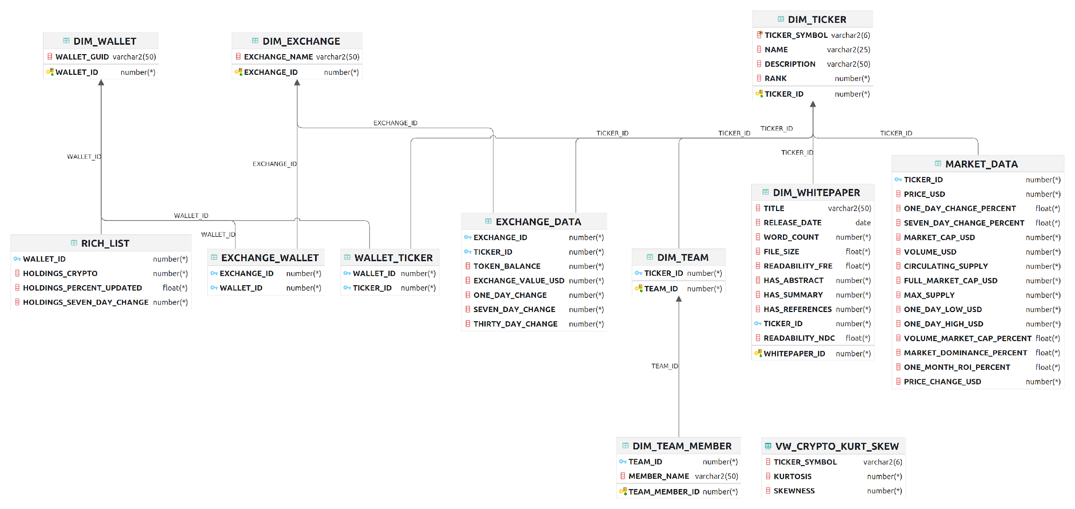
ER Diagram

Slide 4
Data Integrity
Integral table to the database
Primary key and non-nullable value is TICKER_ID
Sequenced primary key that starts at 10001
TICKER_SYMBOL is the “stock market” ticker for each cryptocurrency
Bitcoin is BTC
BinanceCoin is BNB
Dogecoin is DOGE
COLUMN_NAME | DATA_TYPE | NULLABLE
TICKER_ID | NUMBER(38,0) | NO
TICKER_SYMBOL | VARCHAR2(6 BYTE) | YES
NAME | VARCHAR2(25 BYTE) | YES
DESCRIPTION | VARCHAR2(50 BYTE) | YES
RANK | NUMBER(38,0) | YES

Slide 5

Integrity Constraints
Unique public key constraint in the DIM_WALLET table
Non-negative number:
HOLDINGS_CRYPTO in the RICH_LIST table
TOKEN_BALANCE in the EXCHANGE_DATA table
FILESIZE and WORDCOUNT within the DIM_WHITEPAPER table

Slide 6

Data Generation and Loading
Data was scraped with CoinCarp & R script
Scraping application was used for rest of the data (such as RICH_LIST and EXCHANGE data)
For WHITEPAPER data, used Python scripts to scrape the documents and extract the info along with a variety of libraries in Python
For TEAMS and TEAM_MEMBERS, data was entered manually from online resources and organized in Excel
Python was used to clean data and Excel was used to create any sequenced keys

Slide 7

Physical Database Design
Limitation of how to store whitepapers
No whitepapers are stored in our “test” database but we have discussed ways for this to be accomplished
URLs saved in the database
Links to internal server to store whitepapers

Slide 8
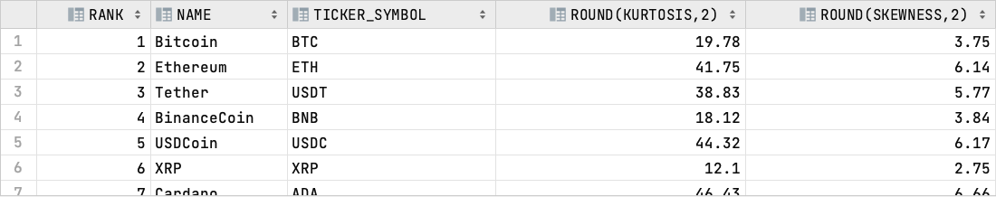
Query Writing
Created a view to calculate kurtosis and skewness for each cryptocurrency
Updated every time RICH_LIST table is updated

Slide 9

Performance Tuning - Compare Indexes
Created two indexes in DIM_TICKER table:
DIM_TICKER_pk used TICKER_ID as the index column
DIM_TICKER_TICKER_SYMBOL_index uses TICKER_SYMBOL
Completed multiple experiments with queries to compare
Based on the results, TICKER_ID-based index was better for amount of data received and sent as well as speed
This is only sometimes the case, but for most of the operations above, this was the best Index for this table

Slide 10

Performance Tuning - Caching
Metadata caching for column names and data types
Data caching for DIM_TICKER, DIM_EXCHANGE and DIM_WHITEPAPER
DIM_TICKER would only be left for a day cached because the ranks change so often
Other data can be cached for at least a month
Query Result Caching is another option for frequently queried results (market cap of Bitcoin)

Slide 11
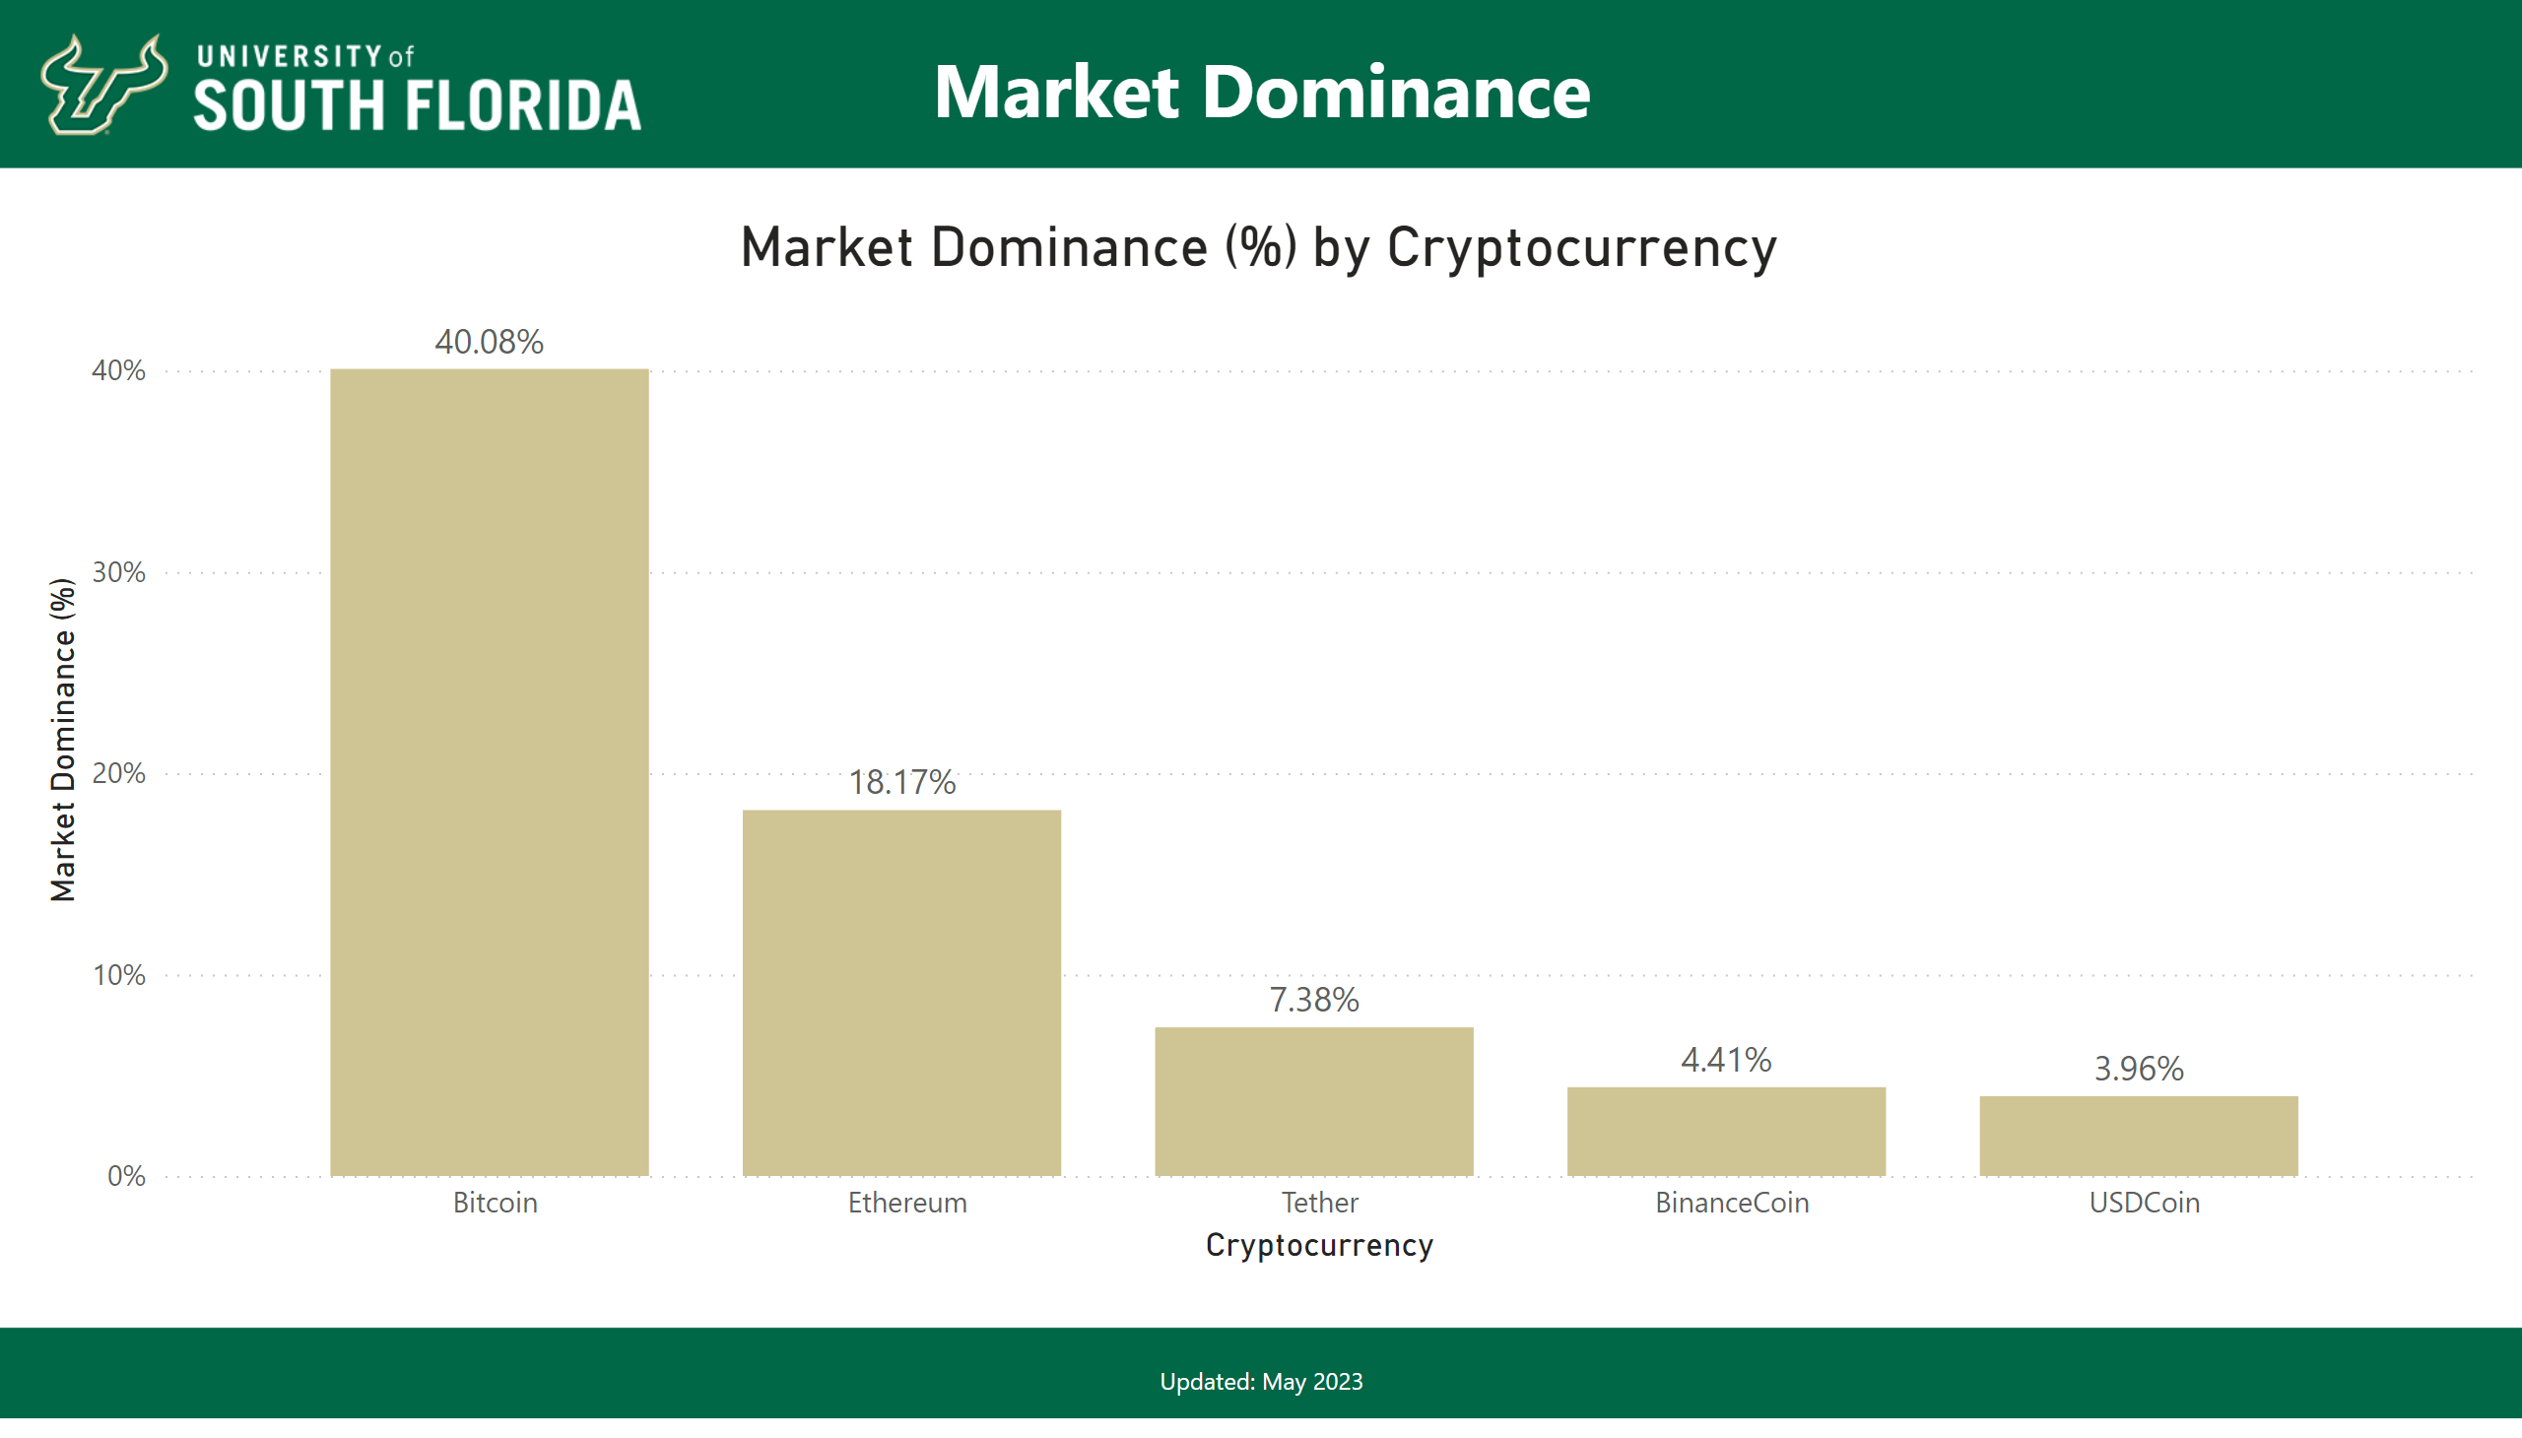
Current Price
Notes:
Market Dominance (%) by Cryptocurrency
No alt text provided
textbox
No alt text provided
textbox
No alt text provided

Slide 12
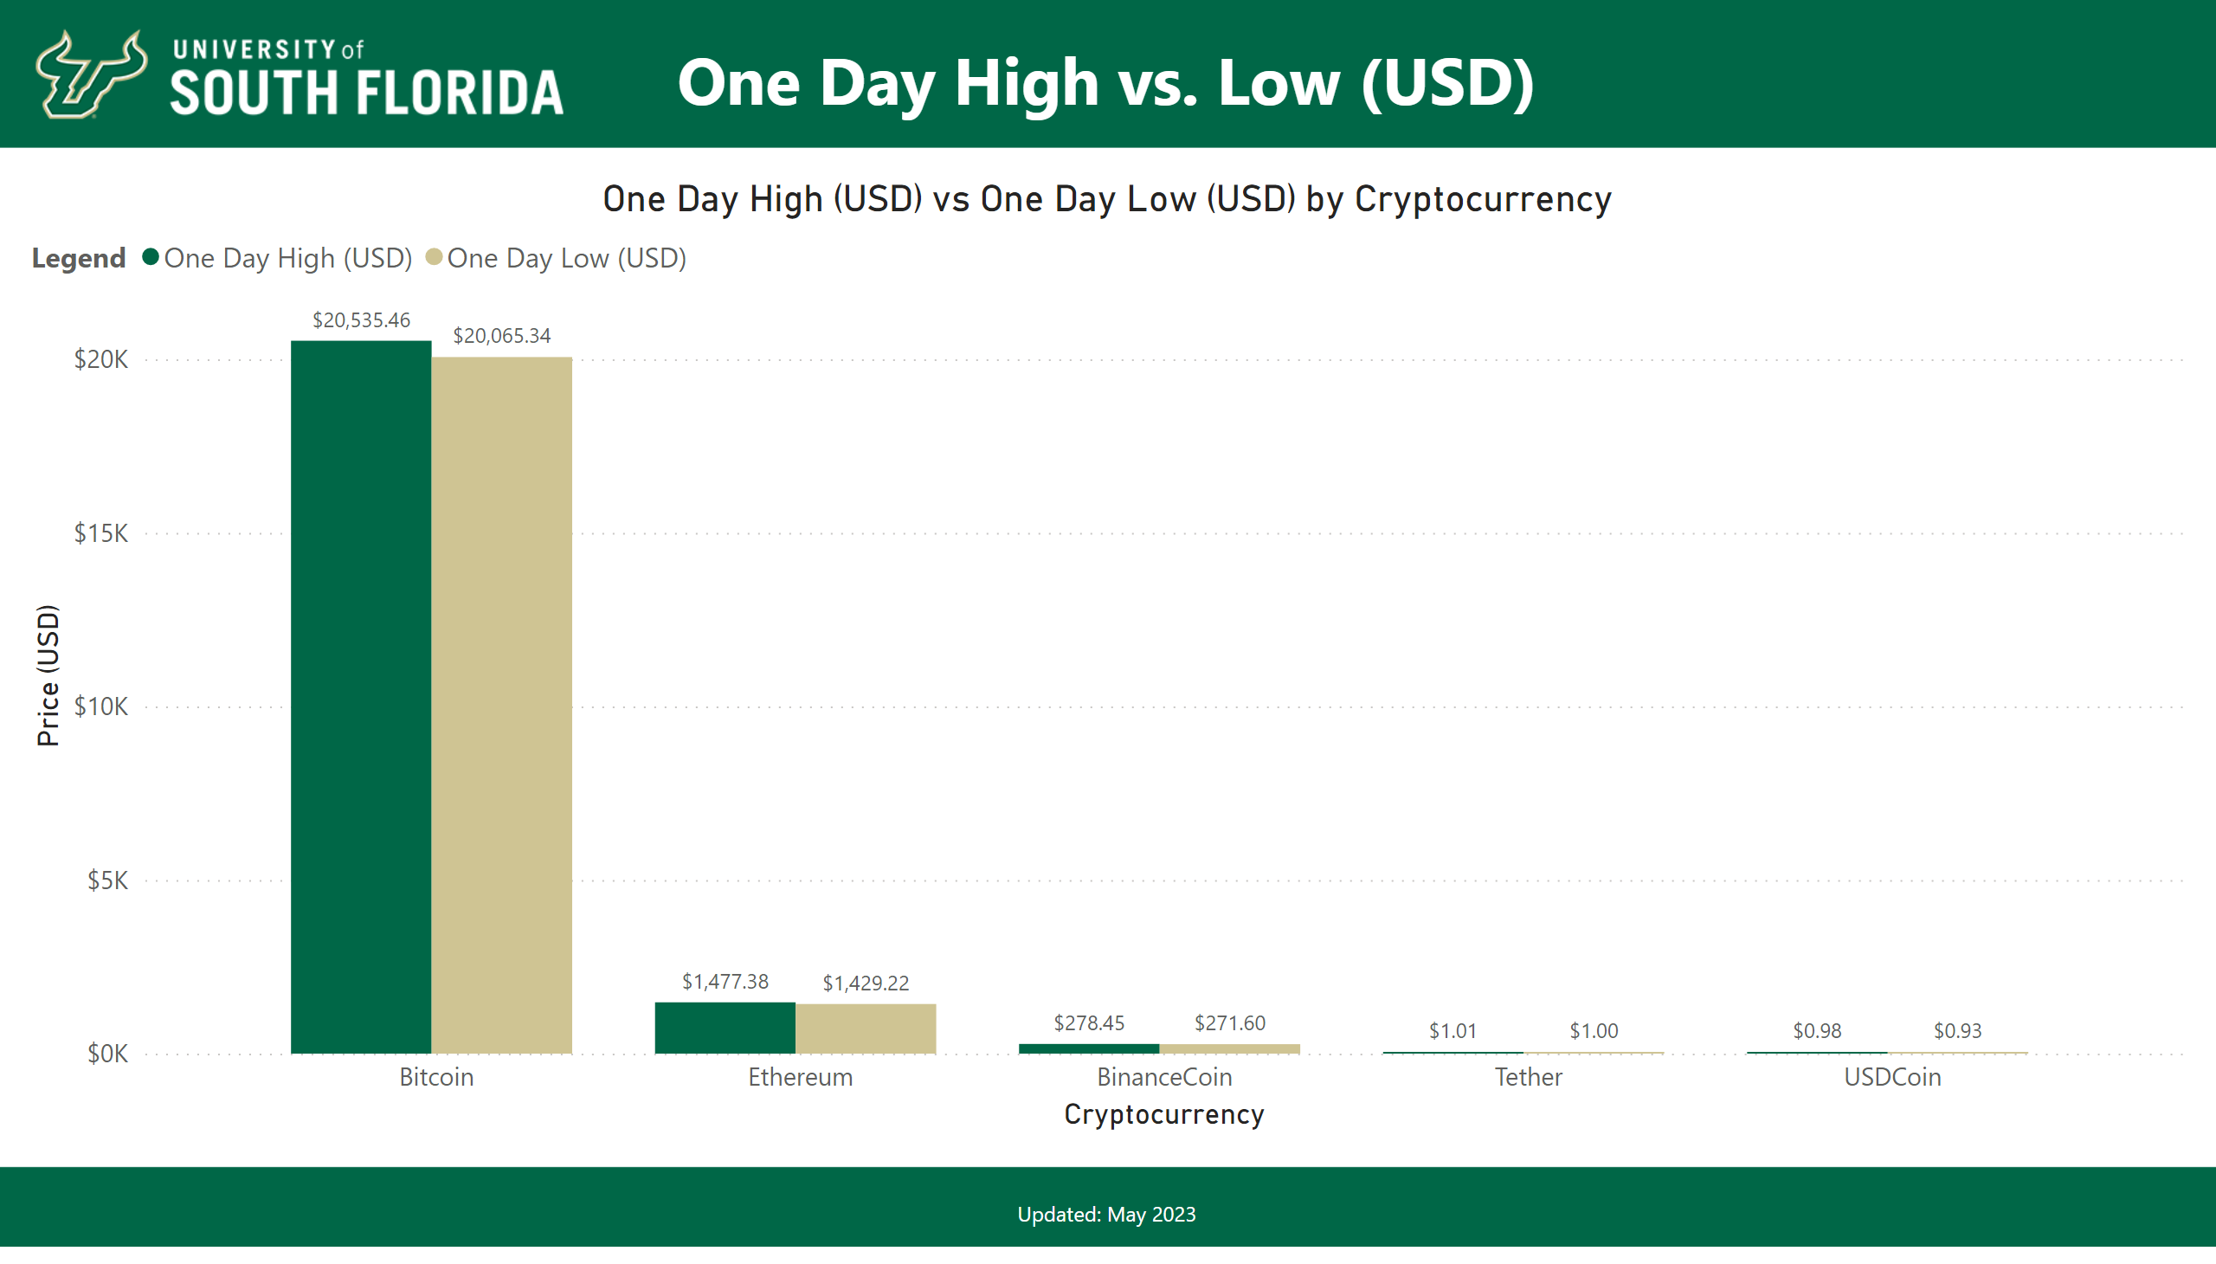
One Day High vs One Day Low
Notes:
One Day High (USD) vs One Day Low (USD) by Cryptocurrency
No alt text provided
textbox
No alt text provided
textbox
No alt text provided

Slide 13
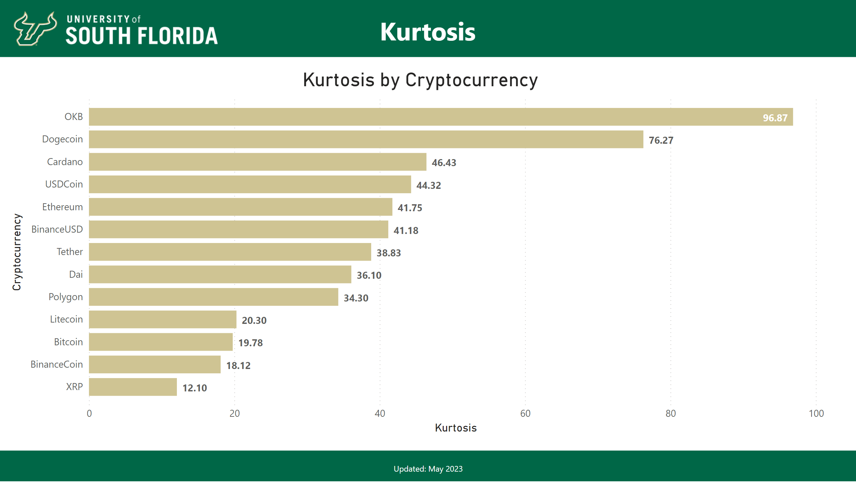
Kurtosis
Notes:
Kurtosis by Cryptocurrency
No alt text provided
textbox
No alt text provided
textbox
No alt text provided

Slide 14
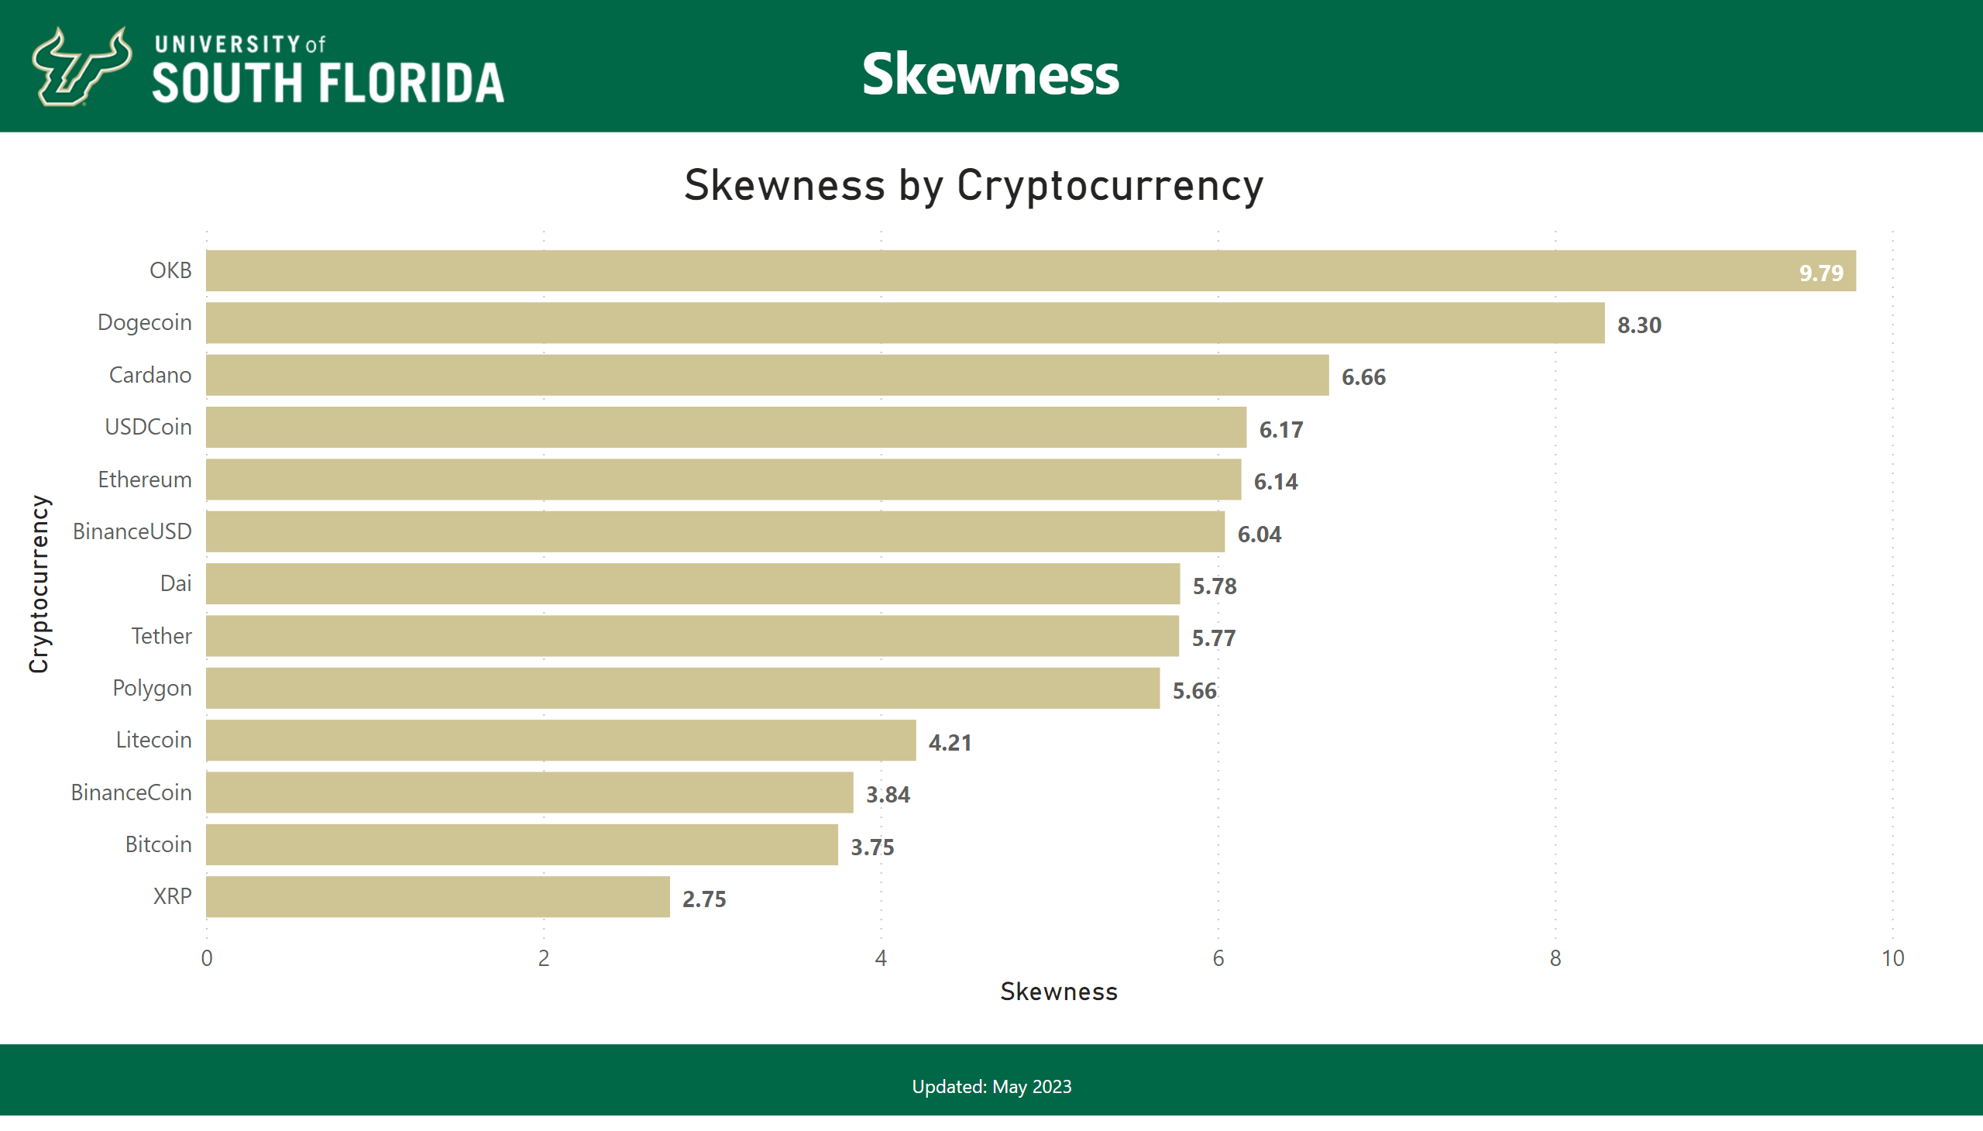
Skewness
Notes:
Skewness by Cryptocurrency
No alt text provided
textbox
No alt text provided
textbox
No alt text provided

